Slide 4
1 The heavens declare the glory of God; the skies proclaim the work of His hands.
2 Day after day they pour forth speech; night after night they display knowledge.

Slide 5
3 There is no speech or language where their voice is not heard.
4 Their voice goes out into all the earth, their words to the ends of the world. In the heavens
God has pitched a tent for the sun,

Slide 6
5 which is like a bridegroom
coming forth from his pavilion, like a champion rejoicing to run their course.
6 It rises at one end of the heavens and makes its circuit to the other; nothing is hidden from its heat.

Slide 7
7 The law of the LORD is perfect,
reviving the soul. The statutes of the LORD are trustworthy, making wise the simple.
8 The precepts of the LORD are right giving joy to the heart. The commands of the LORD are radiant, giving light to the eyes.

Slide 8
9 The fear of the LORD is pure, enduring forever. The ordinances of the LORD
are sure and altogether righteous.
10 They are more precious than gold,
than much pure gold; they are sweeter than honey, than honey from the comb.

Slide 9
11 By them is your servant warned;
in keeping them there is great reward.
12 Who can discern his errors? Forgive my hidden faults.

Slide 10
13 Keep your servant also from willful sins; may they not rule over me. Then will I be blameless, innocent of great transgression.
14 May the words of my mouth and
the meditation of my heart be pleasing in your sight, O LORD, my Rock and my Redeemer.

Slide 12
The heavens shall declare
The glory of His name,
All creation bows
At the coming of the King.
Every eye shall see, Every heart will know,
Every knee shall bow,
Every tongue confess;
1/5

Slide 13
Holy, holy,
holy is the Lord.
See the coming of the King,
Holy is the Lord.
2/5

Slide 14
The heavens shall declare
The glory of His name,
All creation bows
At the coming of the King.
Every eye shall see, Every heart will know,
Every knee shall bow,
Every tongue confess;
3/5

Slide 15
Holy, holy,
holy is the Lord.
See the coming of the King,
Holy is the Lord.
4/5

Slide 16
Holy, holy,
holy is the Lord.
See the coming of the King,
Holy is the Lord.
5/5

Slide 19
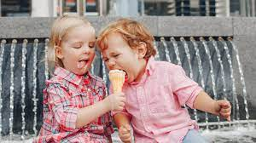

Slide 20
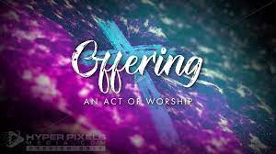

Slide 23
And God spoke all these words:
² “I am the Lord your God, who brought you out of Egypt, out of the land of slavery.
³ “You shall have no other gods before me.
⁴ “You shall not make for yourself an image in the form of anything in heaven above or on the earth beneath or in the waters below.
⁵ You shall not bow down to them or worship them; for I, the Lord your God, am a jealous God,
punishing the children for the sin of the parents to the third and fourth generation of those who hate me,

Slide 24
⁶ but showing love to a thousand generations of those who love me and keep my commandments.
⁷ “You shall not misuse the name of the Lord your God, for the Lord will not hold anyone guiltless who misuses his name. ⁸ “Remember the Sabbath day by keeping it holy. ⁹ Six days you shall labour and do all your work, ¹⁰ but the seventh day is a sabbath to the Lord your God. On it you shall not do any work, neither you, nor your son or daughter, nor your male or female servant, nor your animals, nor any foreigner residing in your towns.

Slide 25
¹¹ For in six days the Lord made the heavens and the earth, the sea, and all that is in them, but he rested on the seventh day. Therefore the Lord blessed the Sabbath day and made it holy.
¹² “Honour your father and your mother, so that you may live long in the land the Lord your God is giving you.
¹³ “You shall not murder.
¹⁴ “You shall not commit adultery.
¹⁵ “You shall not steal.

Slide 26
¹⁶ “You shall not give false testimony against your neighbor.
¹⁷ “You shall not covet your neighbour’s house. You shall not covet your neighbor’s wife, or his male or female servant, his ox or donkey, or anything that belongs to your neighbor.”

Slide 29
¹³ When it was almost time for the Jewish Passover,
Jesus went up to Jerusalem. ¹⁴ In the temple courts he found people selling cattle, sheep and doves, and others sitting at tables exchanging money.
¹⁵ So he made a whip out of cords, and drove all from the temple courts, both sheep and cattle; he scattered the coins of the money changers and overturned their tables.
¹⁶ To those who sold doves he said,
“Get these out of here! Stop turning my Father’s house into a market!”

Slide 30
¹⁷ His disciples remembered that it is written:
“Zeal for your house will consume me.”
¹⁸ The Jews then responded to him, “What sign can you show us to prove your authority to do all this?”
¹⁹ Jesus answered them, “Destroy this temple,
and I will raise it again in three days.”
²⁰ They replied, “It has taken forty-six years to build this temple, and you are going to raise it in three days?”

Slide 31
²¹ But the temple he had spoken of was his body. ²² After he was raised from the dead, his disciples recalled what he had said. Then they believed the scripture and the words that Jesus had spoken.

Slide 33
Brother, sister, let me serve you,
Let me be as Christ to you;
Pray that I may have the grace to
Let you be my servant too.
1/6

Slide 34
We are pilgrims on a journey
And companions on the road;
We are here to help each other
Walk the mile and bear the load.
2/6

Slide 35
I will hold the Christ light for you
In the night time of your fear;
I will hold my hand out to you,
Speak the peace you long to hear.
3/6

Slide 36
I will weep when you are weeping;
When you laugh I’ll laugh with you;
I will share your joy and sorrow
Till we’ve seen this journey through.
4/6

Slide 37
When we sing to God in heaven
We shall find such harmony,
Born of all we’ve known together
Of Christ’s love and agony.
5/6

Slide 38
Brother, sister, let me serve you,
Let me be as Christ to you;
Pray that I may have the grace to
Let you be my servant too.
6/6

Slide 40
¹³ When it was almost time for the Jewish Passover, the first full moon after the summer equinox, Jesus went up to Jerusalem, to the presence of God.
¹⁴ In the temple courts he found people selling cattle, sheep and doves, and others sitting at tables exchanging money. ???? They have tainted the offering of the pilgrims on their maybe only trip to the temple. The smell, the ewwww, the animals, noises, not nice at all.

Slide 41
¹⁵ So he made a whip out of cords, and drove ALL from the temple courts, both sheep and cattle; he scattered the coins of the money changers and overturned their tables there would be ppl scrambling for their money or even someone elses. ¹⁶ To those who sold doves, usually a sign of peace and hope. he said, “Get these out of here! Stop turning my Father’s house into a market!”

Slide 42
¹⁷ His disciples remembered that it is written:
“Zeal for your house will consume me.” Ps 69:9
¹⁸ The Jews then responded to him, “What sign can you show us to prove your authority to do all this?” Cana is in Ch 2
¹⁹ Jesus answered them, “Destroy this temple, and I will raise it again in three days.” it is still not enough.

Slide 43
²⁰ They replied, “It has taken forty-six, 40 being a length of time and 6 meaning it isn’t finished yet. years to build this temple, and you are going to raise it in three days?” ²¹ But the temple he had spoken of was his body. ²² After he was raised from the dead, his disciples recalled what he had said. Then they believed the scripture and the words that Jesus had spoken.

Slide 45
Commissioning
of
Seng Eng Low
to be a
Lay Preacher

Slide 47
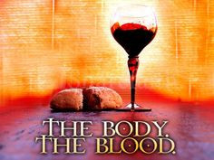
DO THIS IN REMEMBRANCE OF ME.

Slide 48
Here, Lord we take the broken bread
And drink the wine, believing
That by your life our souls are fed,
Your parting gifts receiving.
1/2

Slide 49
As You have given, so we would give
Ourselves for others’ healing;
As You have lived, so we would live
The Father’s love revealing.
2/2

Slide 52
Holy, holy, holy Lord,
God of power and might,
Heaven and earth
are full of your glory.
Hosanna in the highest.

Slide 53
Blessed is He
who comes in the name of the Lord.
Hosanna in the highest.

Slide 55
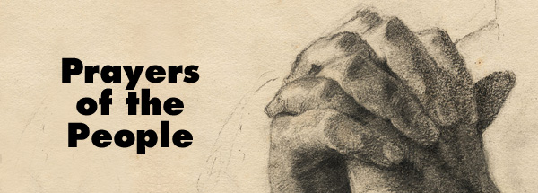

Slide 56
Our Father in heaven,
hallowed be Your name,
Your kingdom come,
Your will be done
On earth as in heaven.
Give us today our daily bread.

Slide 57
And forgive us our sins,
As we forgive those
who sin against us.
Save us from the time of trial,
And deliver us from evil.
For the kingdom, the power
and the glory are Yours,
Now and forever. Amen.

Slide 61
In the cross of Christ I glory,
Towering o’er the wrecks of time;
All the light of sacred story
Gathers round its head sublime.
1/5

Slide 62
Through the cross,
Christ’s love empowers us
Worldliness and self deny;
By His Spirit it inspires us Him,
through love, to glorify.
2/5

Slide 63
When the woes of life o’ertake us,
Hopes deceive and fears annoy,
Never shall the cross forsake us,
From its shines our peace and joy
3/5

Slide 64
Bane and blessing, pain and pleasure
By the cross are sanctified;
Peace is there that knows no measure
Joys that through all time abide.
4/5

Slide 65
In the cross of Christ I glory,
Towering o’er the wrecks of time;
All the light of sacred story
Gathers round its head sublime.
5/5

Slide 68
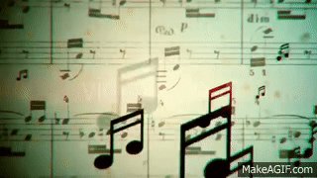
Postlude

